Slide 1
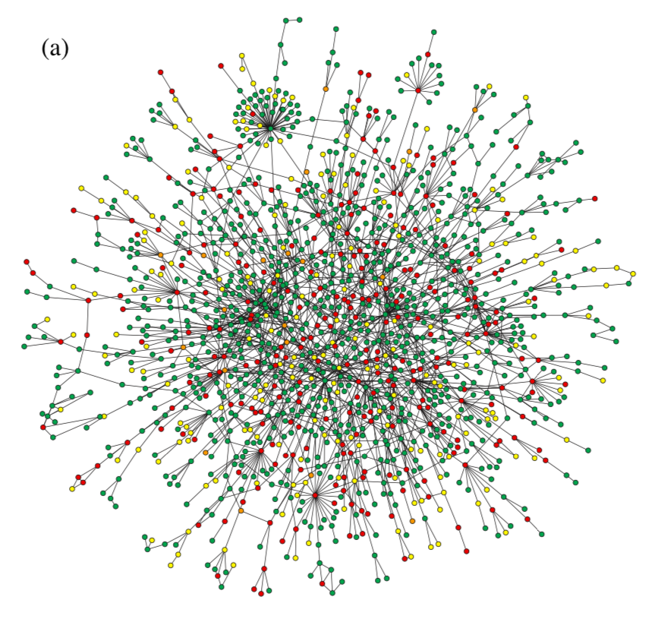
Geometric characteristics of real-world networks
Heather M. Guarnera
The College of Wooster

Slide 2
Why graph networks?

Slide 3
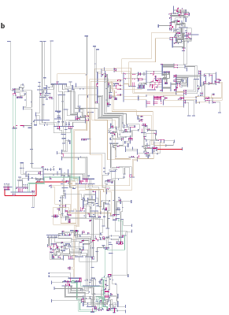
Graphs are everywhere
computer network
NYS Electric
Power Grid

Slide 4

Graphs are everywhere
Utility Patent network
1972-1999
(3 Million patents)

Slide 5
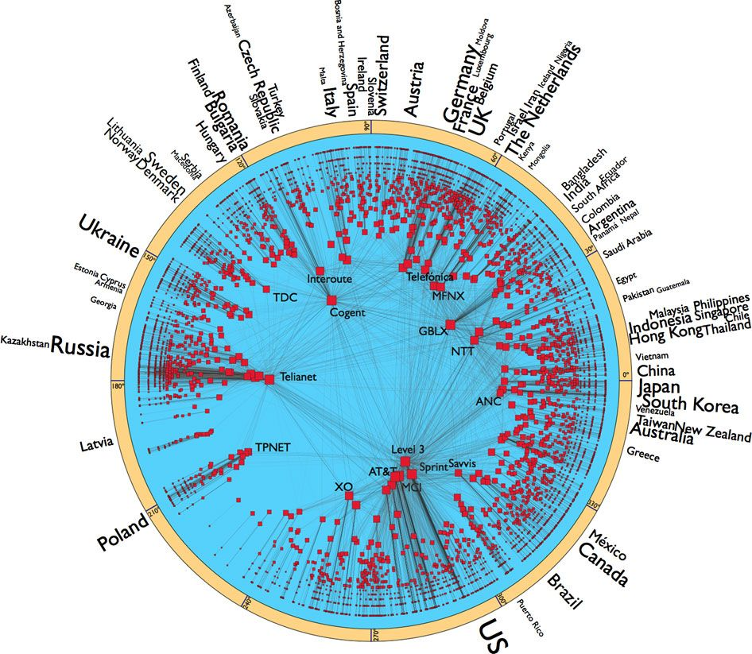
Graphs are everywhere
Internet (AS-level)
nodes n = 23,752 autonomous systems
edges m = 58,416 AS links
Notes:
AS-Level internet graph (AS is a collection of routers whose prefixes and routing policies are under common administrative control. This could be a network service provider, a large company, a university, a division of a company, or a group of companies. The AS represents a connected group of one or more blocks of IP addresses, called IP prefixes, that have been assigned to that organization and provides a single routing policy to systems outside the AS. Autonomous Systems create a two-level hierarchy for routing in the Internet)
* nodes = 23752 autonomous systems (AS)
* size is proportional to the logarithm of their degrees
* only AS with deg >3 is shown
* font size of countries proportional to logarithm of the number of ASs the country has
* only countries with more than 10 ASs are included
* edges = 58416 AS links
* data collected by the archipelago active measurement infrastructure developed by Cooperative Association for Internet Data Analysis
* hb(G) <= 2.5 (as measured from various DIMES and CAIDA data sets)

Slide 6
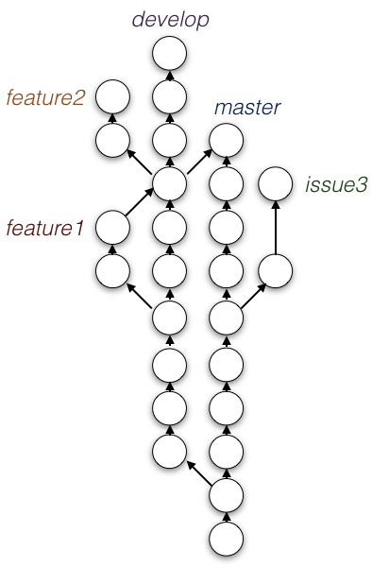

Graphs are everywhere

Slide 7
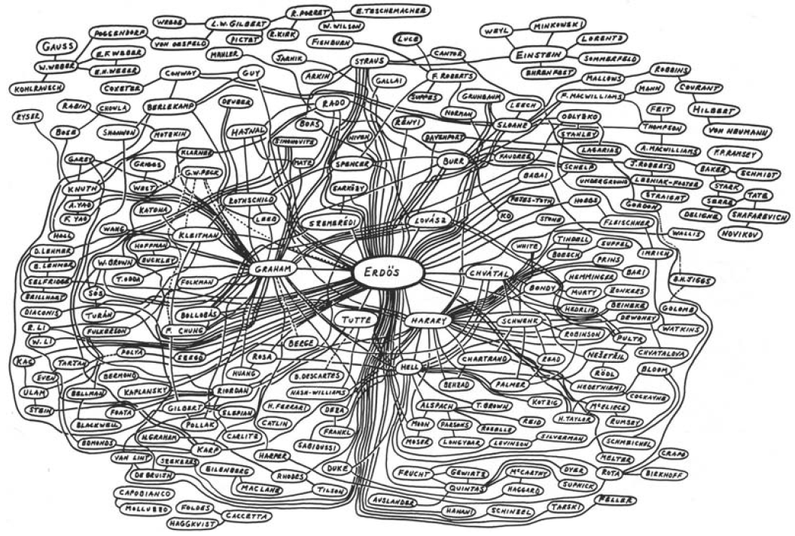
Graphs are everywhere

Slide 8
What is Fellow Travelers Phenomenon?

Slide 9
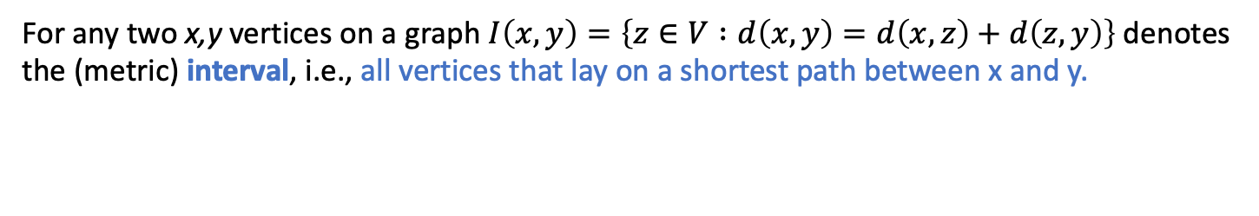
(Interval) Thinness of graphs
For any two x,y vertices on a graph $I\left(x,y\right)=\left\{z∈V :d\left(x,y\right)=d\left(x,z\right)+d\left(z,y\right)\right\}$denotes the (metric) interval, i.e., all vertices that lay on a shortest path between x and y.
x
y

Slide 10
(Interval) Thinness of graphs
For any two x,y vertices on a graph $I\left(x,y\right)=\left\{z∈V :d\left(x,y\right)=d\left(x,z\right)+d\left(z,y\right)\right\}$denotes the (metric) interval, i.e., all vertices that lay on a shortest path between x and y.
x
y

Slide 11

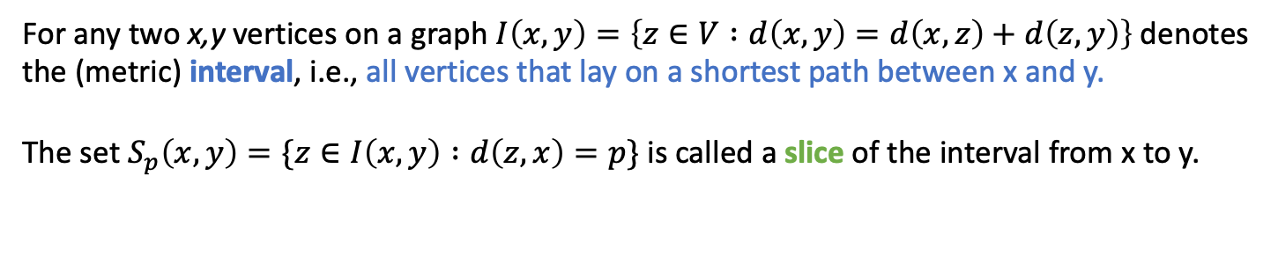
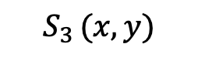
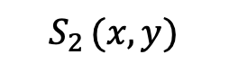
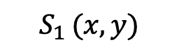
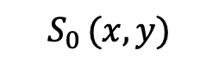
(Interval) Thinness of graphs
For any two x,y vertices on a graph $I\left(x,y\right)=\left\{z∈V :d\left(x,y\right)=d\left(x,z\right)+d\left(z,y\right)\right\}$denotes the (metric) interval, i.e., all vertices that lay on a shortest path between x and y.
The set $S_{p}\left(x,y\right)=\{z∈I\left(x,y\right) :d\left(z,x\right)=p\}$ is called a slice of the interval from x to y.
x
y
$$S_{0 }(x,y)$$
$$S_{4 }(x,y)$$
$$S_{1 }(x,y)$$
$$S_{3 }(x,y)$$
$$S_{2 }(x,y)$$

Slide 12
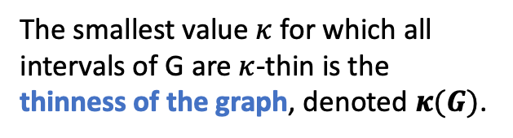
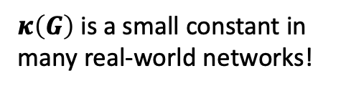

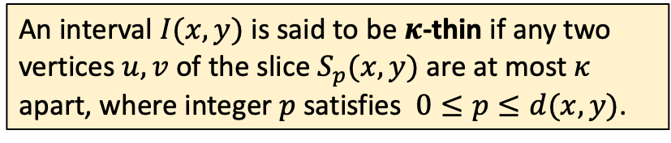
(Interval) Thinness of graphs
For any two x,y vertices on a graph $I\left(x,y\right)=\left\{z∈V :d\left(x,y\right)=d\left(x,z\right)+d\left(z,y\right)\right\}$denotes the (metric) interval, i.e., all vertices that lay on a shortest path between x and y.
The set $S_{p}\left(x,y\right)=\{z∈I\left(x,y\right) :d\left(z,x\right)=p\}$ is called a slice of the interval from x to y.
An interval $I(x,y)$ is said to be $κ$-thin if any two vertices $u,v$ of the slice $S_{p}(x,y)$ are at most $κ$ apart, where integer $p$ satisfies $0≤p≤d(x,y)$.
Ex: $I(x,y)$ is 2-thin.
x
y
The smallest value $κ$ for which all intervals of G are $κ$-thin is the thinness of the graph, denoted $κ(G)$.
$$S_{0 }(x,y)$$
$$S_{4 }(x,y)$$
$$S_{1 }(x,y)$$
$$S_{3 }(x,y)$$
$κ\left(G\right)$ is a small constant in many real-world networks!
$$S_{2 }(x,y)$$

Slide 13
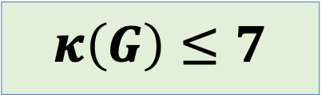
Ex: Protein Interaction Network
nodes n = 1,870 proteins
edges m = 2240 direct physical interactions between proteins
$$κ\left(G\right)≤7$$

Slide 14
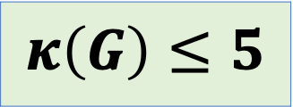
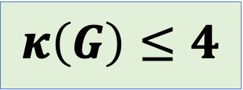
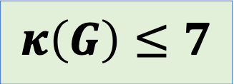
Ex: Other real-world networks with small thinness
Social networks (subset of Facebook)
nodes n = 293,501 users
edges m = 5,589,802 friendships between users
Web networks (from Google)
nodes n = 855,802 websites
edges m = 4,291,352 hyperlinks connecting sites
Peer-to-peer networks (Gnutella)
nodes n = 62,561 hosts
edges m = 147,878 connections between hosts
$$κ\left(G\right)≤7$$
$$κ\left(G\right)≤4$$
$$κ\left(G\right)≤5$$

Slide 15
Fellow travelers phenomenon is attributed to the negative curvature of the graph

Slide 16
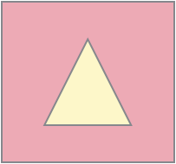
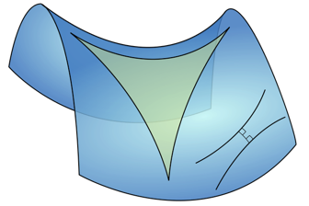
Geometric characteristics of real-world networks
Surge of recent empirical and theoretical work analyzes geometric characteristics
One important property: negative curvature
causes traffic between vertices to pass through a relatively small core of the network – as if the shortest paths between them were curved inwards
measured in many different (somewhat equivalent) ways
Zero Curvature
Negative Curvature
Notes:
In a metric space with zero curvature, such as the Euclidean space we all know and love, each angle of an equilateral triangle is exactly 60*
Instead, negative curvature in a metric space indicates that an equilateral triangle has angles less than 60*
* There are some metric spaces known to be hyperbolic, such as a Poincare disk (shown here),
* In a metric space or graph with negative curvature, we see this sort of bending property in shortest paths.
It’s been shown that hyperbolic graphs embed with better accuracy into a hyperbolic space than into a Euclidean space of comparable dimension.

Slide 17
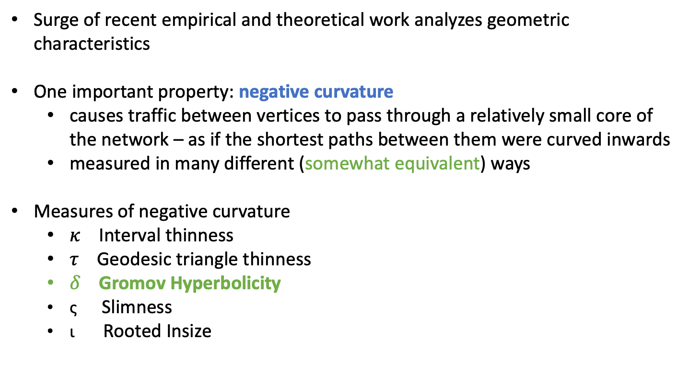
Geometric characteristics of real-world networks
Surge of recent empirical and theoretical work analyzes geometric characteristics
One important property: negative curvature
causes traffic between vertices to pass through a relatively small core of the network – as if the shortest paths between them were curved inwards
measured in many different (somewhat equivalent) ways
Measures of negative curvature
$κ$ Interval thinness
$τ$ Geodesic triangle thinness
$δ$ Gromov Hyperbolicity
ς Slimness
ι Rooted Insize
Notes:
In a metric space with zero curvature, such as the Euclidean space we all know and love, each angle of an equilateral triangle is exactly 60*
Instead, negative curvature in a metric space indicates that an equilateral triangle has angles less than 60*
* There are some metric spaces known to be hyperbolic, such as a Poincare disk (shown here),
* In a metric space or graph with negative curvature, we see this sort of bending property in shortest paths.
It’s been shown that hyperbolic graphs embed with better accuracy into a hyperbolic space than into a Euclidean space of comparable dimension.

Slide 18
How can this geometric information be applied?

Slide 19
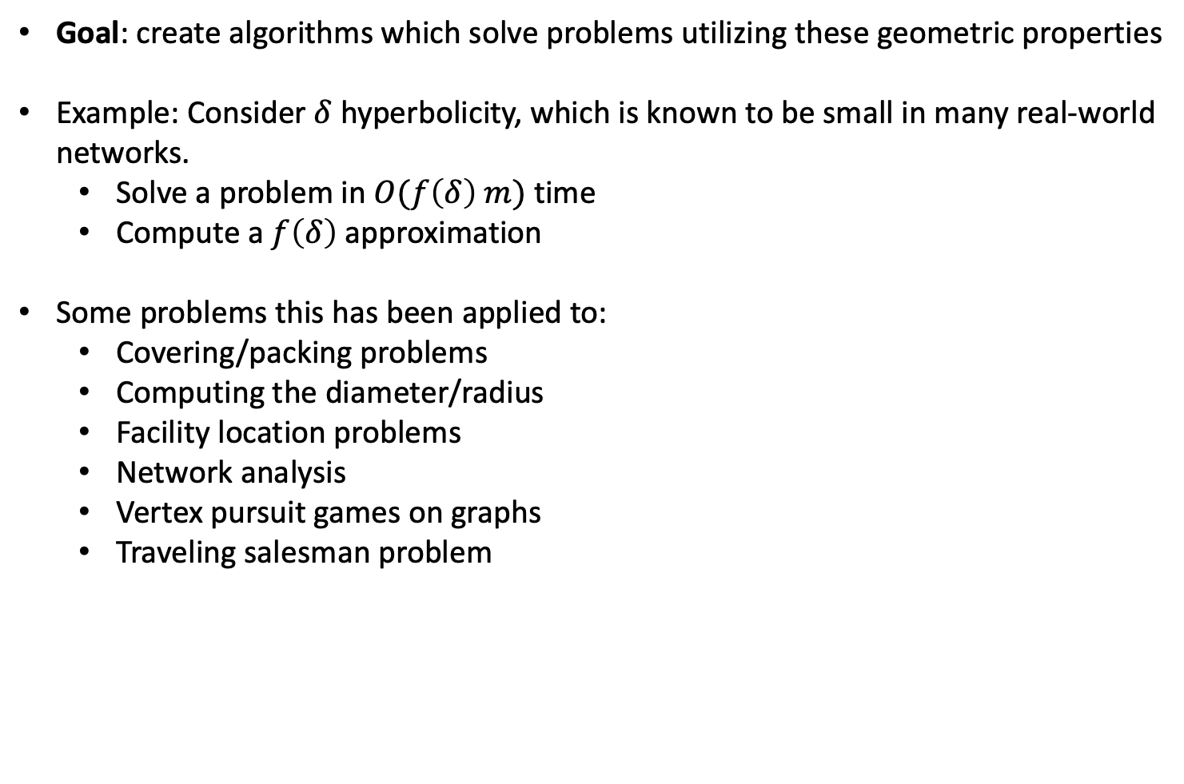
Parameterized complexity/approximation factor
Goal: create algorithms which solve problems utilizing these geometric properties
Example: Consider $δ$ hyperbolicity, which is known to be small in many real-world networks.
Solve a problem in $O(f\left(δ\right) m)$ time
Compute a $f\left(δ\right)$ approximation
Some problems this has been applied to:
Covering/packing problems
Computing the diameter/radius
Facility location problems
Network analysis
Vertex pursuit games on graphs
Traveling salesman problem
Notes:
Many recent empirical and theoretical work measures and analyzes geometric characteristics of real-world networks

Slide 20
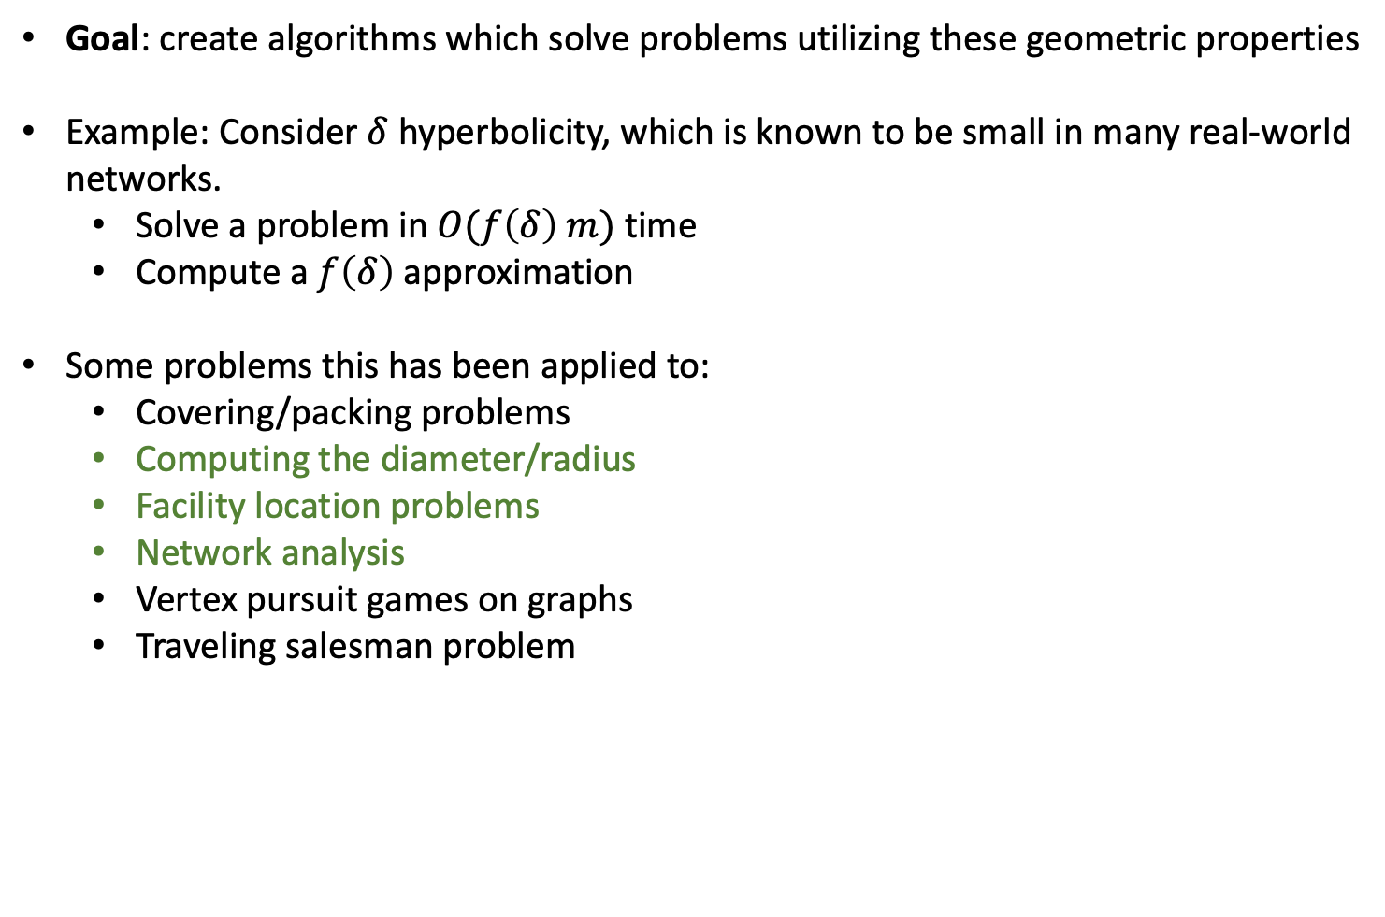
Parameterized complexity/approximation factor
Goal: create algorithms which solve problems utilizing these geometric properties
Example: Consider $δ$ hyperbolicity, which is known to be small in many real-world networks.
Solve a problem in $O(f\left(δ\right) m)$ time
Compute a $f\left(δ\right)$ approximation
Some problems this has been applied to:
Covering/packing problems
Computing the diameter/radius
Facility location problems
Network analysis
Vertex pursuit games on graphs
Traveling salesman problem
F. Dragan and H. Guarnera. Helly-gap of a graph and vertex eccentricities. Theoretical Computer Science, 867:68-84, 2021.
F. Dragan and H. Guarnera. Eccentricity function in distance-hereditary graphs. Theoretical Computer Science, 833: 26-40, 2020.
F. Dragan and H. Guarnera. Eccentricity terrain of 𝛿-hyperbolic graphs. Journal of Computer and System Sciences, 112: 50-56, 2020.
F. Dragan, G. Ducoffe, H. Guarnera. Fast deterministic algorithms for computing all eccentricities in (hyperbolic) Helly graphs, the 17th Algorithms and Data Structures Symposium (WADS'21), 2021.
Mohammed, F. Dragan, H. Guarnera. Fellow Travelers Phenomenon Present in Real-World Networks, Complex Networks & Their Applications, 2022.
Notes:
Many recent empirical and theoretical work measures and analyzes geometric characteristics of real-world networks

Slide 21
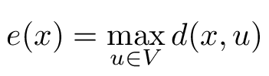
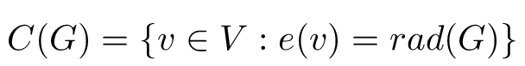
Example: eccentricity function and centers
The eccentricity e(x) of a vertex x is the distance to a furthest u vertex to x
The minimum and maximum eccentricities are called the radius rad(G) and diameter diam(G) of the graph, respectively
3
3
3
The center of a graph C(G) is the set of vertices with minimum eccentricity
4
3
2
3
4
Applications:
Measure the importance of a node (centrality indices)
Facility location problems
Detecting small-world networks (degrees of freedom)
Notes:
Many recent empirical and theoretical work measures and analyzes geometric characteristics of real-world networks

Slide 22
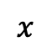
Computing vertex eccentricities straightforwardly.
The eccentricity e(x) of a vertex x is the distance to a furthest u vertex to x
Take a connected graph with n vertices and m edges.
A single Breadth-First Search (BFS) from a vertex x
runs in O(m) time
yields e(x)
Call BFS for each of the n vertices
Total O(nm) runtime
$$x$$
This is prohibitively expensive on many real-world networks, as they are huge!
Notes:
Many recent empirical and theoretical work measures and analyzes geometric characteristics of real-world networks

Slide 23
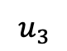

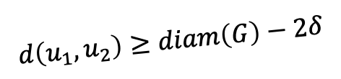
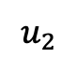
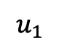
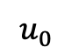
Efficient eccentricity approximation via eccentricity approximating spanning tree
Find a long path in $O(m)$ time
$$u_{0}$$
$$u_{1}$$
$$d\left(u_{1},u_{2}\right)≥diam\left(G\right)−2δ$$
$$u_{3}$$
$$u_{2}$$
Notes:
Many recent empirical and theoretical work measures and analyzes geometric characteristics of real-world networks

Slide 24
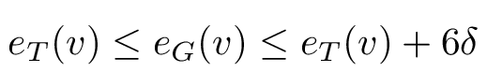
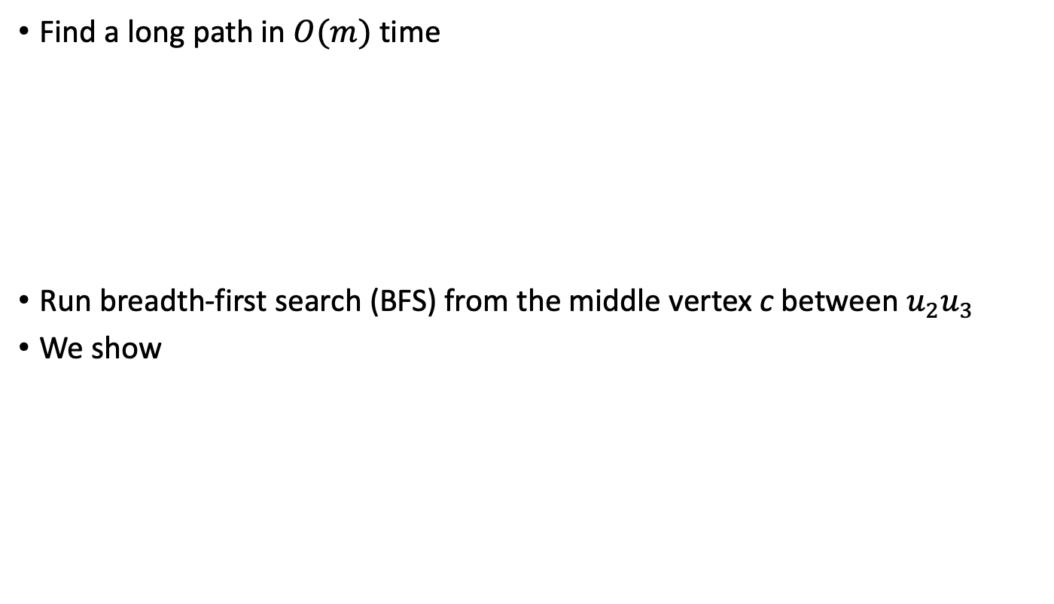
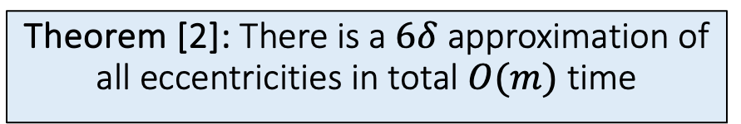
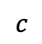
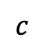
Efficient eccentricity approximation via eccentricity approximating spanning tree
Find a long path in $O(m)$ time
Run breadth-first search (BFS) from the middle vertex c between $u_{2}u_{3}$
We show
$$u_{3}$$
$$u_{2}$$
$$c$$
T
Theorem [2]: There is a $6δ$ approximation of all eccentricities in total $O(m)$ time
$$c$$
[2] F. Dragan and H. Guarnera. Eccentricity terrain of 𝛿-hyperbolic graphs. Journal of Computer and System Sciences, 112: 50-56, 2020.
Notes:
Many recent empirical and theoretical work measures and analyzes geometric characteristics of real-world networks

Slide 25
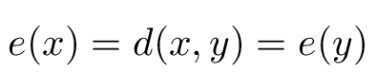
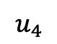
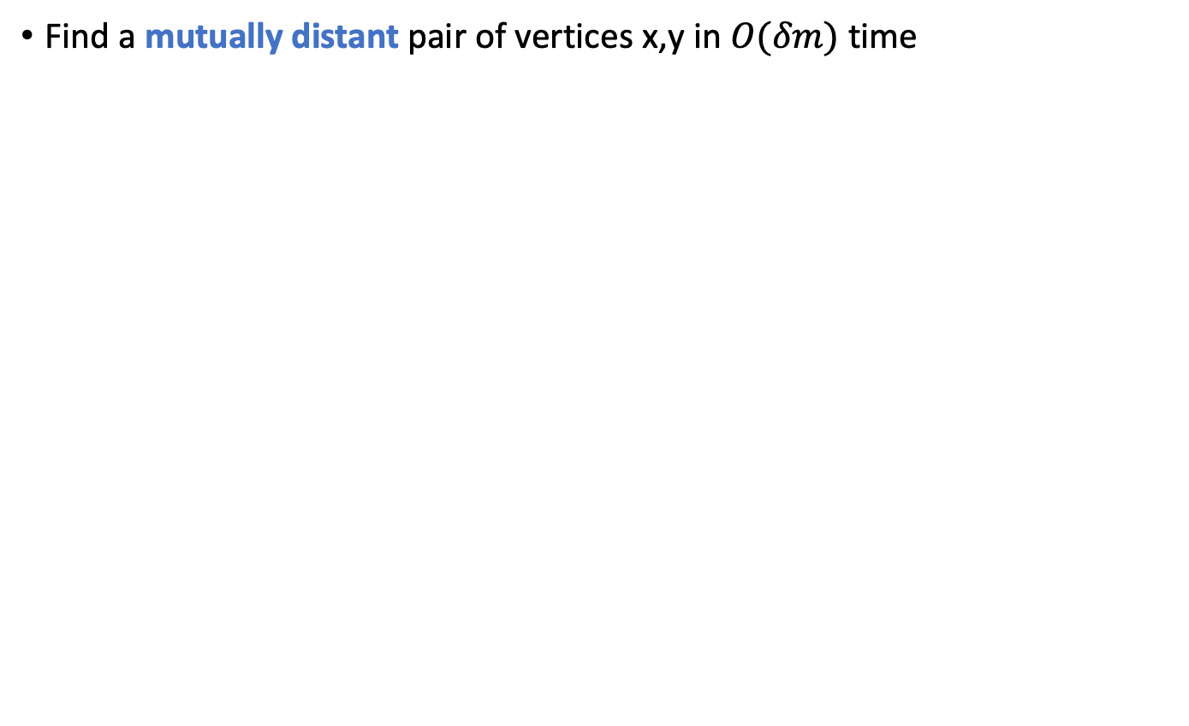
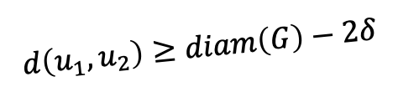
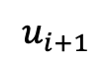
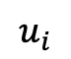
Efficient eccentricity approximation via eccentricity approximating spanning tree
Find a mutually distant pair of vertices x,y in $O(δm)$ time
$$u_{0}$$
$$u_{1}$$
$$d\left(u_{1},u_{2}\right)≥diam\left(G\right)−2δ$$
$$u_{3}$$
$$u_{2}$$
$$u_{4}$$
…
$$u_{i+1}$$
$$u_{i}$$
Notes:
Many recent empirical and theoretical work measures and analyzes geometric characteristics of real-world networks

Slide 26

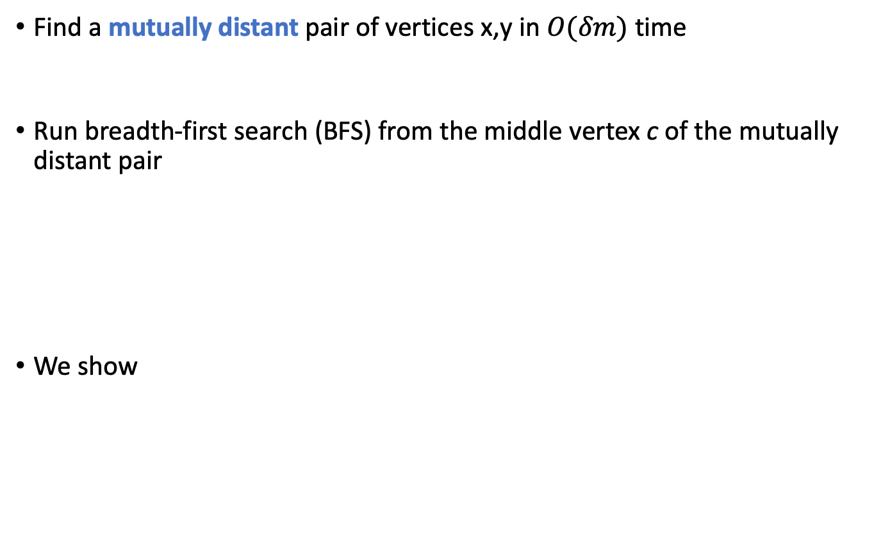
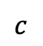
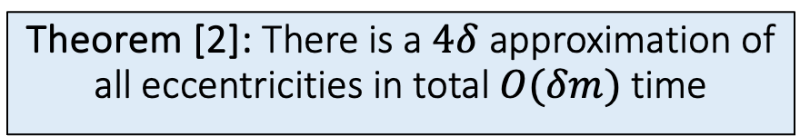
Efficient eccentricity approximation via eccentricity approximating spanning tree
Find a mutually distant pair of vertices x,y in $O(δm)$ time
Run breadth-first search (BFS) from the middle vertex c of the mutually distant pair
We show
$$u_{i+1}$$
$$u_{i}$$
$$c$$
T
Theorem [2]: There is a $4δ$ approximation of all eccentricities in total $O(δm)$ time
$$c$$
[2] F. Dragan and H. Guarnera. Eccentricity terrain of 𝛿-hyperbolic graphs. Journal of Computer and System Sciences, 112: 50-56, 2020.
Notes:
Many recent empirical and theoretical work measures and analyzes geometric characteristics of real-world networks

Slide 27
Conclusion
Many real world networks exhibit the fellow travelers property
Biological networks
Communication networks
Social networks
Software ecosystems
We can take advantage of this nice geometric property to solve problems faster on these networks
Ex: computing vertex eccentricities

Slide 28
Conclusion and future work
Many real world networks exhibit the fellow travelers property
Biological networks
Communication networks
Social networks
Software ecosystems
What else?
We can take advantage of this nice geometric property to solve problems faster on these networks
Ex: computing vertex eccentricities
What else? Ex: vertex pursuit games
Routes:
Theoretical
Applied

Slide 29
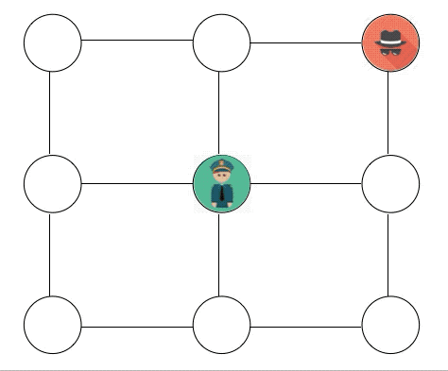
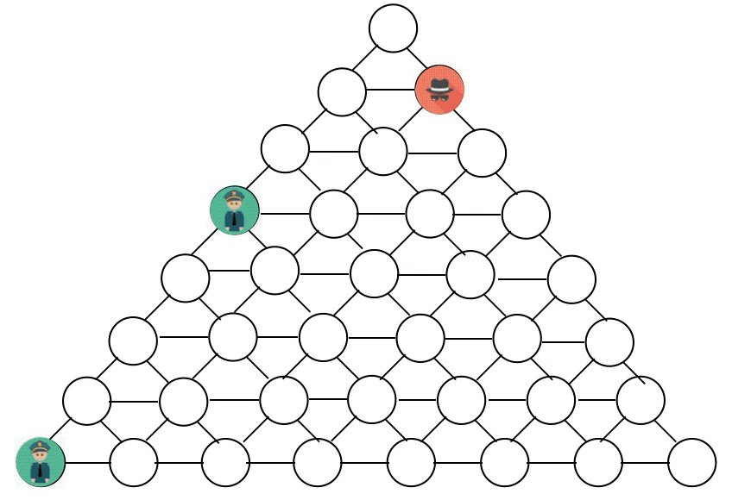
Games on graphs: cops vs. robbers
cop-win
robber-win

Slide 30
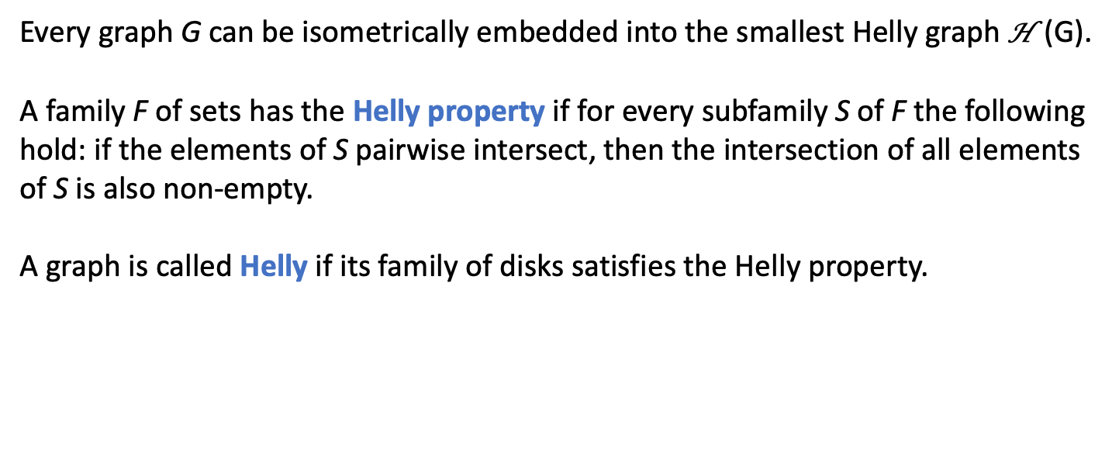
Paths for Future Work (Theoretical)
Every graph G can be isometrically embedded into the smallest Helly graph H (G).
A family F of sets has the Helly property if for every subfamily S of F the following hold: if the elements of S pairwise intersect, then the intersection of all elements of S is also non-empty.
A graph is called Helly if its family of disks satisfies the Helly property.
Not Helly
Helly

Slide 31
Paths for Future Work (Theoretical)
Every graph G can be isometrically embedded into the smallest Helly graph H (G).
H (G) is called the injective hull of G [Isbell 1964, Dress 1984].
H (G) preserves hyperbolicity
If G is δ-hyperbolic, then any vertex of H (G) is within 2δ to a vertex of G [Lang 2013]
[1] Any vertex of H (G) is within α(G) to a vertex of G, where α(G) is the Helly-gap.
This motivates finding solutions to problems in H (G) which can lead to approximate solutions in G.
[1] F. Dragan and H. Guarnera. Helly-gap of a graph and vertex eccentricities. Theoretical Computer Science, 867:68-84, 2021.

Slide 32
Paths for Future Work (Theoretical)
H (G) can be constructed efficiently [6] for some graph classes (e.g., distance-hereditary graphs).
It is computationally difficult to compute for other (even basic) graph classes [6]
Investigate other graph classes (alpha-i metric graphs, chordal graphs, etc.)
The existence of H (G) is a powerful tool to gain insight into a graph class from various perspectives
structurally
metrically
algorithmically
It lends itself nicely to approximation algorithms dependent on α(G).
Apply those algorithms to specific graph classes
what other classes are closed under Hellification?
what parameters are preserved?
what else can be solved?
[6] Heather M. Guarnera, Feodor F. Dragan, and Arne Leitert. Injective hulls of various graph classes. Graphs and Combinatorics 38, 112 (2022).

Slide 33
Paths for Future Work (Applied)
Analyze existing real-world networks
Biological networks
Communication networks
Social networks
Software ecosystems
Compute values of graph parameters on existing networks
Form conjectures for theoretical work
Optimize algorithms to run efficiently on enormous networks
Mining software repositories

Slide 34
Network analysis: software ecosystems

Slide 35
























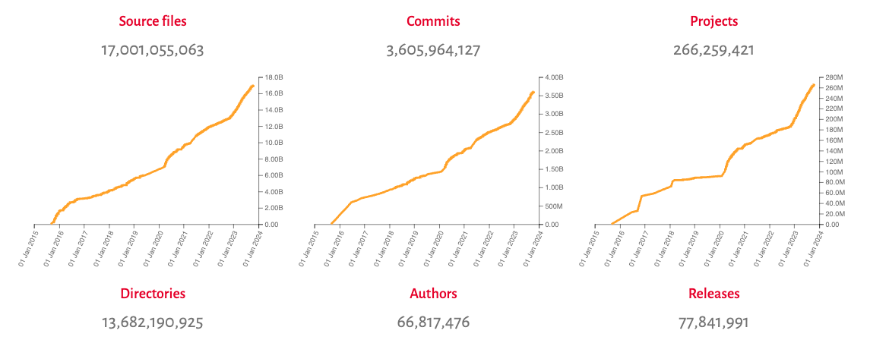
Software Heritage Project

Slide 36
Thank you! Questions?

